Slide 1
Lecture # 27-28 Graphs
Dr. M. Nadeem

Slide 2
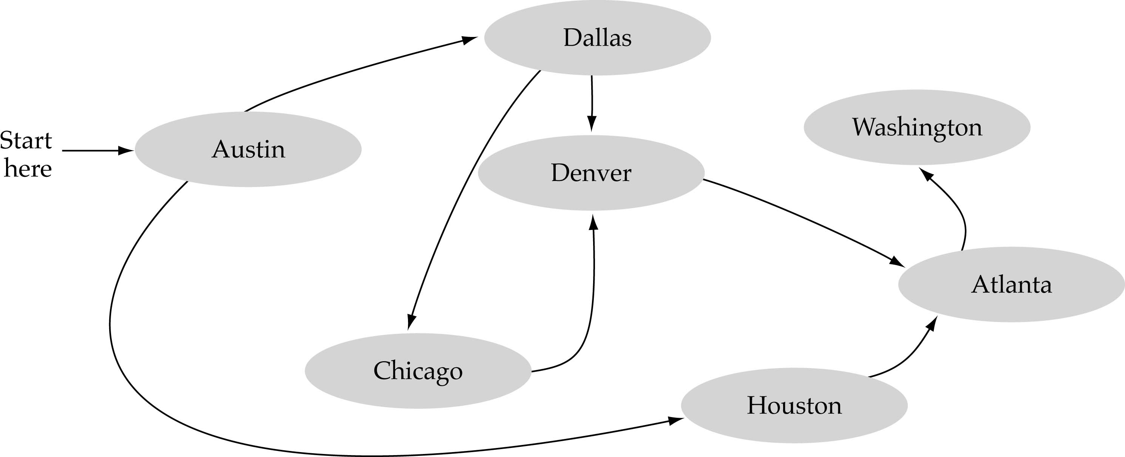
What is a graph?
A data structure that consists of a set of nodes (vertices) and a set of edges that relate the nodes to each other
The set of edges describes relationships among the vertices

Slide 3
Formal definition of graphs
A graph G is defined as follows:
G=(V,E)
V(G): a finite, nonempty set of vertices
E(G): a set of edges (pairs of vertices)

Slide 4
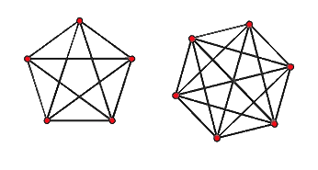
So What is graph ?
Node: Each element of a graph is called node of a graph
Edge :Line joining two nodes is called an edge
= Vertices
= Edeges

Slide 5
Types of graphs
There are two types of graphs
Directed graph
Undirected graph

Slide 6
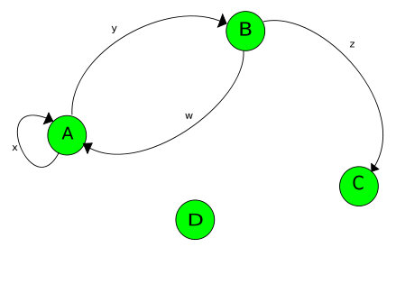
Directed graph
A graphs G is called directed graph if each edge has a direction.

Slide 7
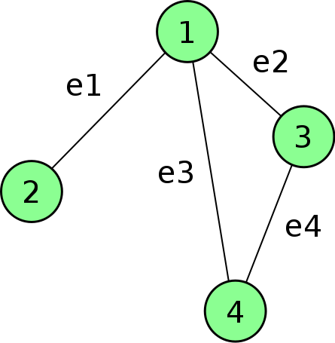
Un Directed graph
A graphs G is called undirected graph if each edge has no direction.

Slide 8
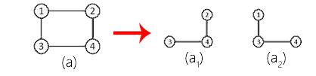
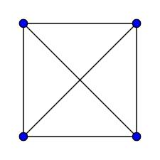
Some different types of graph
Sub graph
Complete graph

Slide 9
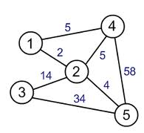
3. Weighted graph

Slide 10
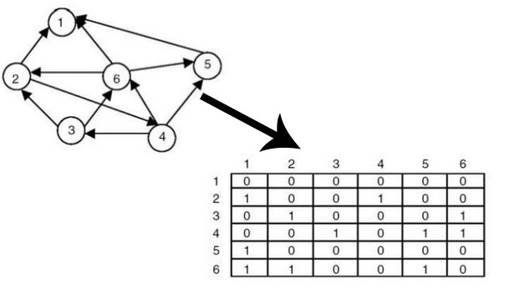
Representation of graphs
Graphs can be represented in 2 ways :
Array representation

Slide 11
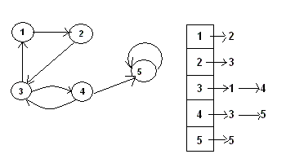
Linked list representation

Slide 12
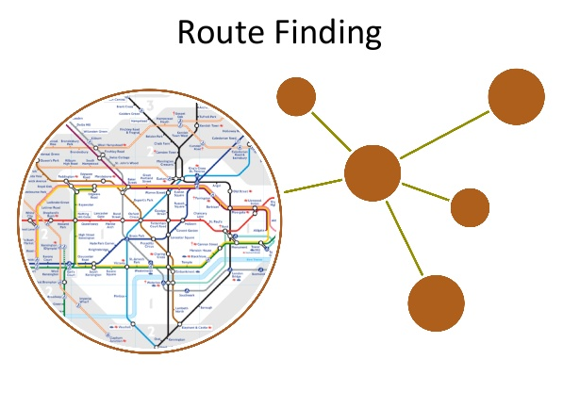
Graph Applications

Slide 13

Graph Applications

Slide 14

Graph Applications

Slide 15
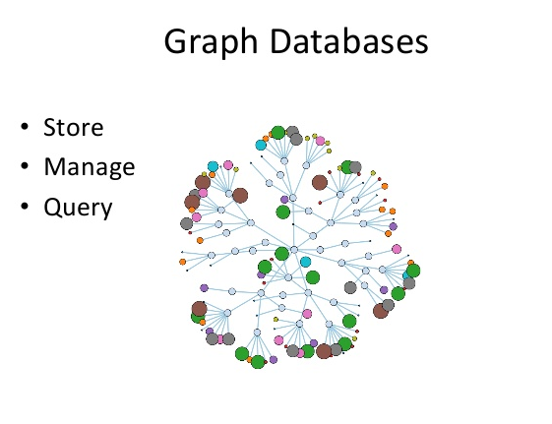
Graph Applications

Slide 16
Graph Applications
electronic circuits
networks (roads, flights, communications)
CS16
JFK
LAX
LAX
STL
HNL
DFW
FTL

Slide 17
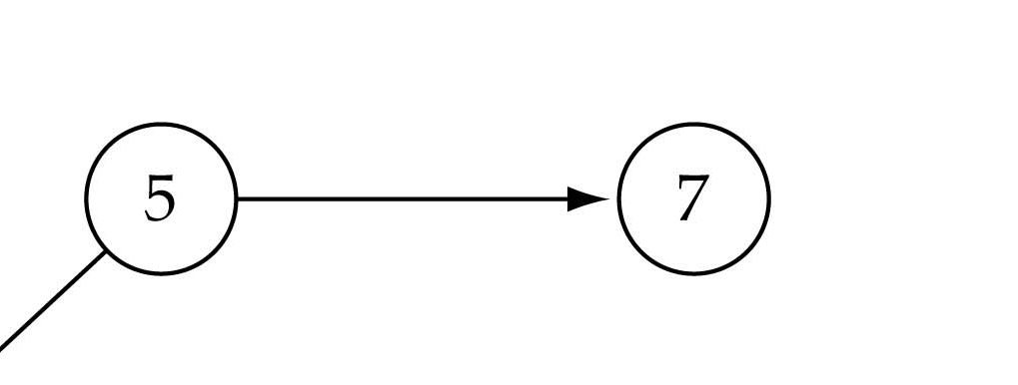
Graph terminology
Adjacent nodes: two nodes are adjacent if they are connected by an edge
Path: a sequence of vertices that connect two nodes in a graph
Complete graph: a graph in which every vertex is directly connected to every other vertex
5 is adjacent to 7
7 is adjacent from 5

Slide 18
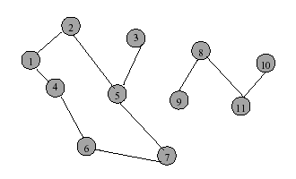
Graph terminology (cont.)
A cycle is a simple path with the same start and end vertex.
The degree of vertex i is the no. of edges incident on vertex i.
e.g., degree(2) = 2, degree(5) = 3, degree(3) = 1

Slide 19
Graph terminology (cont.)
Loops: edges that connect a vertex to itself
Paths: sequences of vertices p0, p1, … pm such that each adjacent pair of vertices are connected by an edge
Multiple Edges: two nodes may be connected by >1 edge
Simple Graphs: have no loops and no multiple edges

Slide 20
Graph terminology (cont.)
simple path: no repeated vertices
cycle: simple path, except that the last vertex is the same as the first vertex
a
b
b e c
c
d
e

Slide 21
Graph terminology (cont.)
connected graph: any two vertices are connected by some path
connected
not connected
subgraph: subset of vertices and edges forming a graph

Slide 22
Graph terminology (cont.)
Subgraphs Examples
0
0
0
1
2
0
1
2
1
2
3
1
2
3
G1
(i) (ii) (iii) (iv)
(a) Some of the subgraph of G₁
3
0
0
0
0
0
1
1
1
1
2
2
2
(i) (ii) (iii) (iv)
(b) Some of the subgraph of G₃
G3

Slide 23
Graph terminology (cont.)
tree - connected graph without cycles
forest - collection of trees

Slide 24
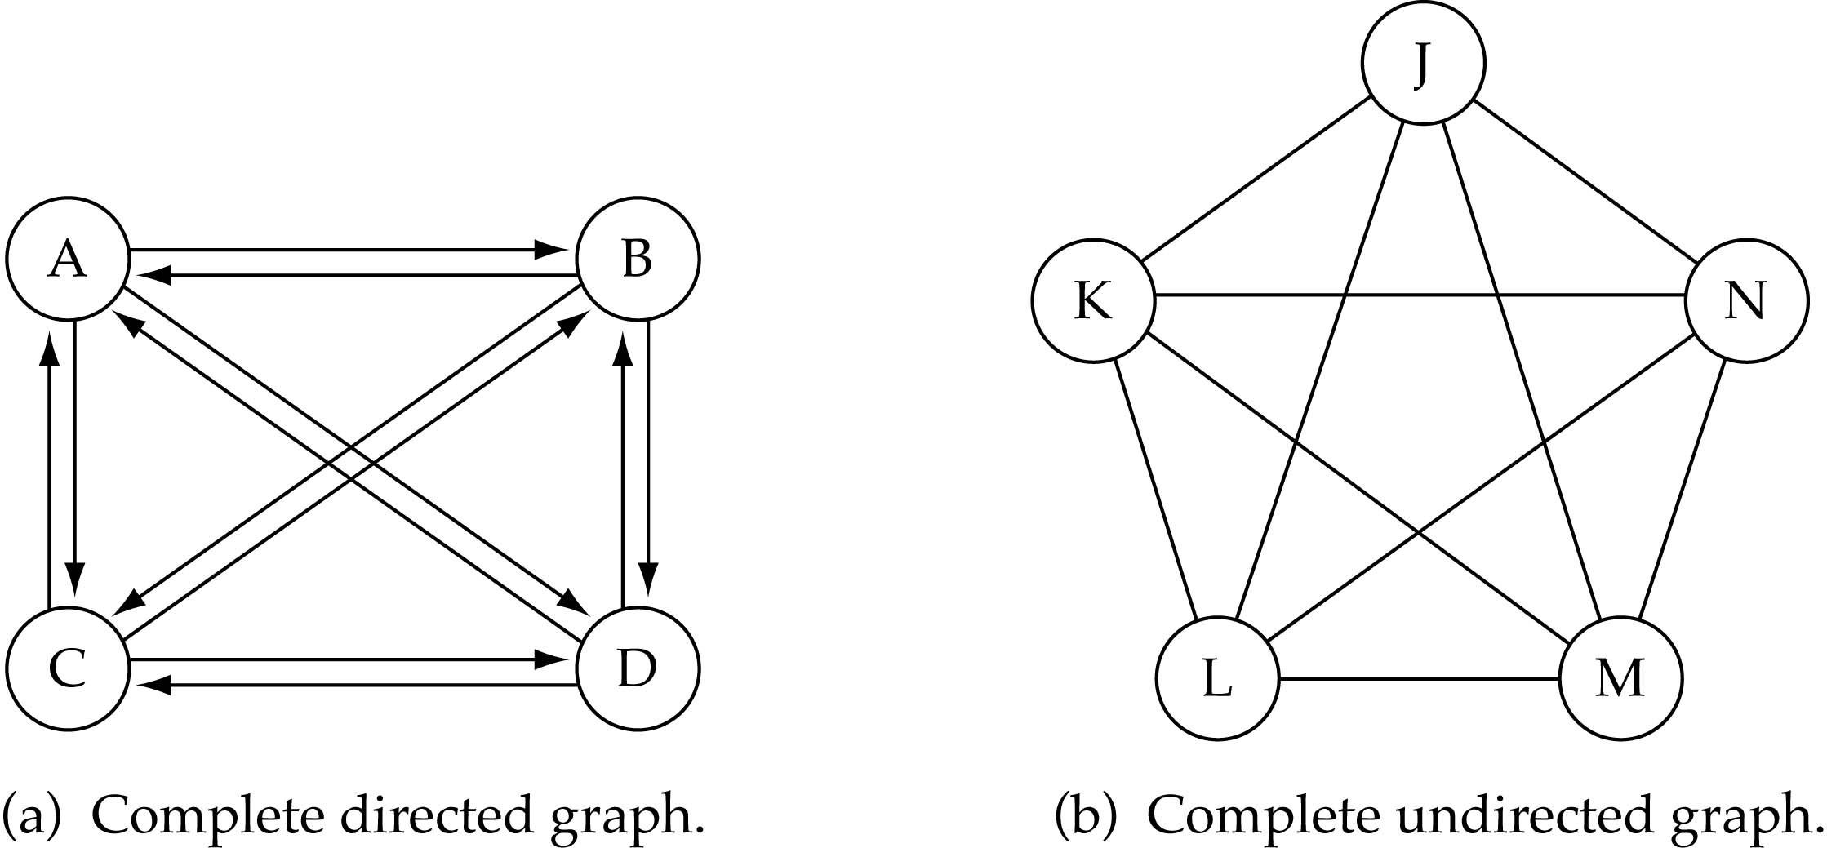
Graph terminology (cont.)
What is the number of edges in a complete directed graph with N vertices?
N * (N-1)

Slide 25
Graph terminology (cont.)
What is the number of edges in a complete undirected graph with N vertices?
N * (N-1) / 2

Slide 26
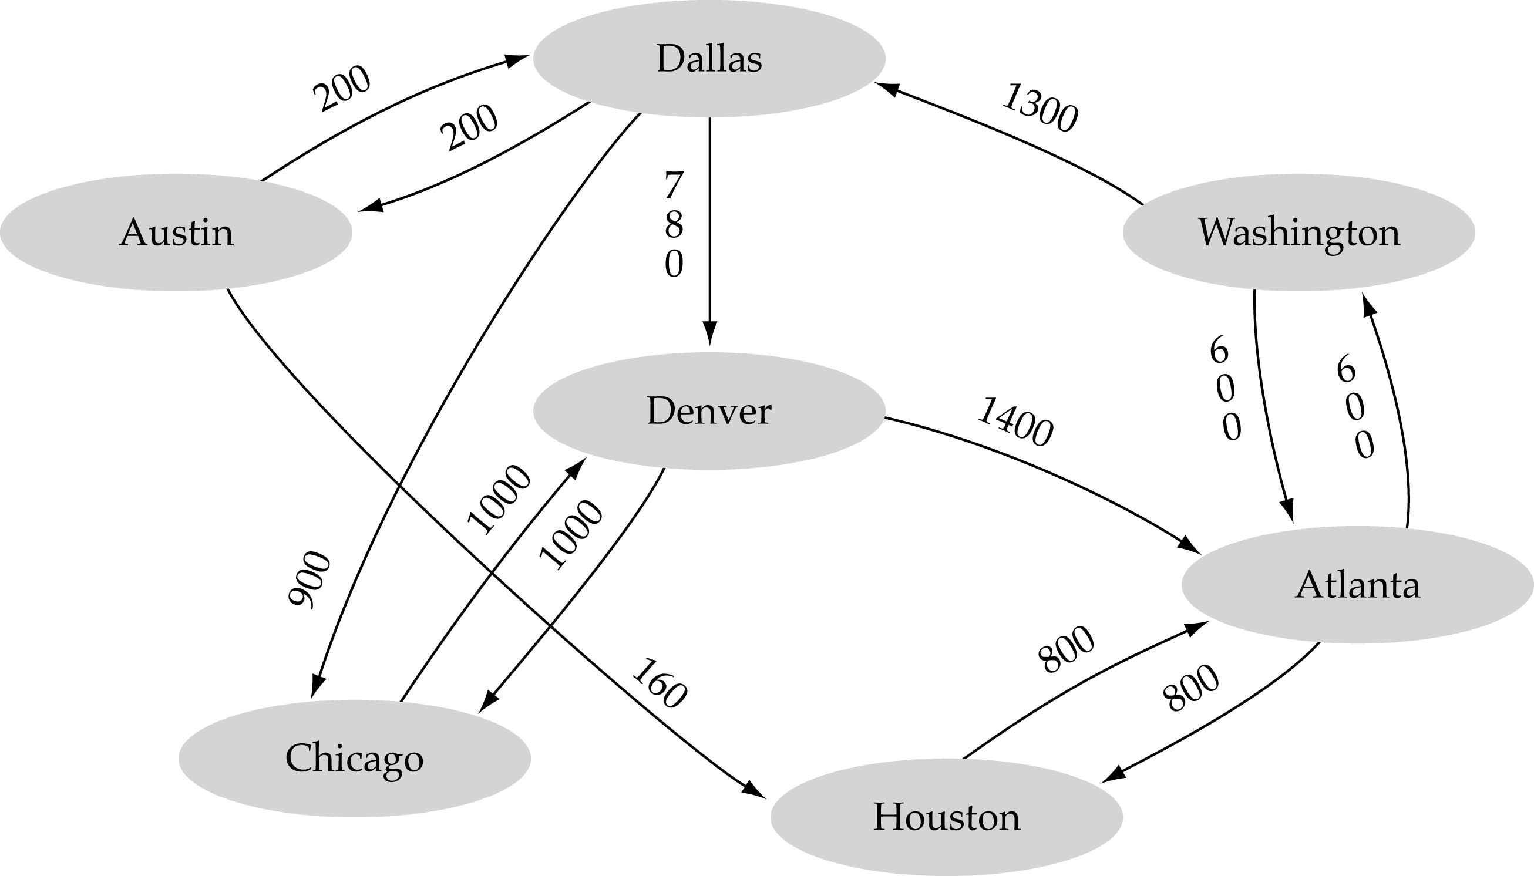
Graph terminology (cont.)
Weighted graph: a graph in which each edge carries a value

Slide 27
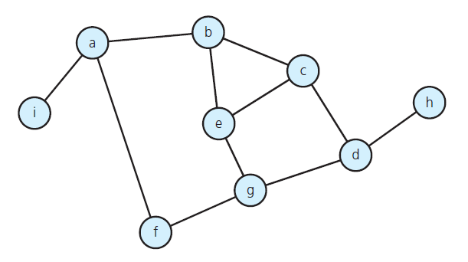
Graph Properties
Number of Edges – Undirected Graph
The no. of possible pairs in an n vertex graph is n*(n-1)
Since edge (u,v) is the same as edge (v,u), the number of edges in an undirected graph is n*(n-1)/2.

Slide 28
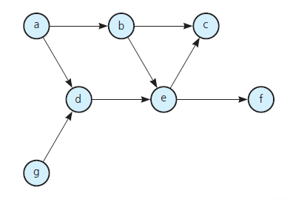
Number of Edges - Directed Graph
Graph Properties
The no. of possible pairs in an n vertex graph is n*(n-1)
Since edge (u,v) is not the same as edge (v,u), the number of edges in a directed graph is n*(n-1)
Thus, the number of edges in a directed graph is ≤ n*(n-1)

Slide 29
Graph Properties
degree of a vertex in an undirected graph
# of nodes in adjacency list
out-degree of a vertex in a directed graph
# of nodes in its adjacency list
in-degree of a vertex in a directed graph
traverse the whole data structure

Slide 30

Graph Properties
In-degree example
e.g., indegree(2) = 1, indegree(8) = 0
Out-degree example
e.g., outdegree(2) = 1, outdegree(8) = 2

Slide 31
Graph Representation
For graphs to be computationally useful, they have to be conveniently represented in programs
There are two computer representations of graphs:
Adjacency matrix representation
Adjacency lists representation

Slide 32
Graph Representation
Adjacency Matrix
A square grid of boolean values
If the graph contains N vertices, then the grid contains N rows and N columns
For two vertices numbered I and J, the element at row I and column J is true if there is an edge from I to J, otherwise false

Slide 33
Adjacency Matrix
Graph Representation
1
3
0 1 2 3 4
0 false false true false false
1 false false false true false
2 false true false false true
3 false false false false false
4 false false false true false
2
4
0

Slide 34
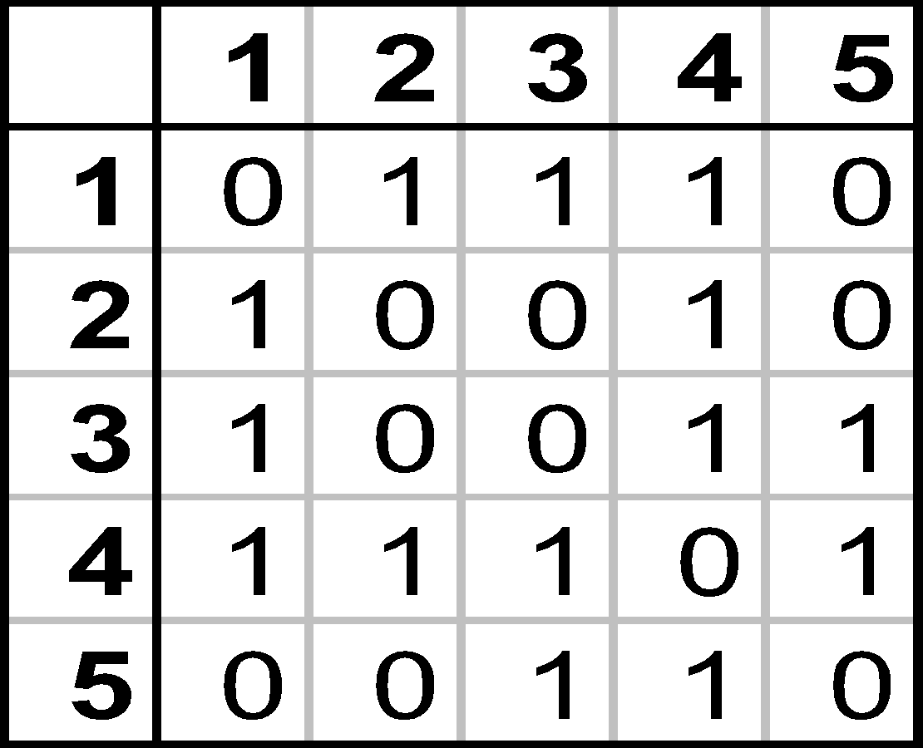
Adjacency Matrix
Graph Representation
1
2
3
4
5

Slide 35
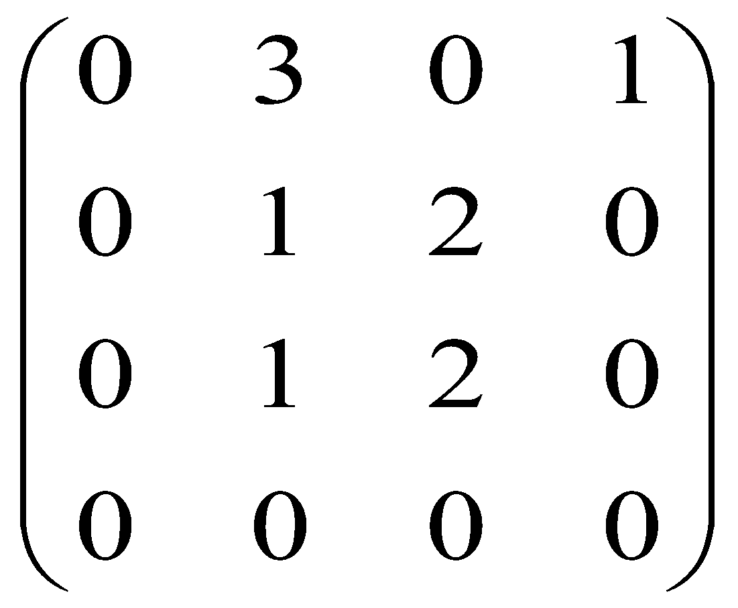
Adjacency Matrix: -Directed Multigraphs
Graph Representation
2
A:
1
4
3

Slide 36
Adjacency Lists Representation
Graph Representation
A graph of n nodes is represented by a one-dimensional array L of linked lists, where
L[i] is the linked list containing all the nodes adjacent from node i.
The nodes in the list L[i] are in no particular order

Slide 37
Graphs: Adjacency List
Graph Representation
Adjacency list: for each vertex v ∈ V, store a list of vertices adjacent to v
Example:
Adj[1] = {2,3}
Adj[2] = {3}
Adj[3] = {}
Adj[4] = {3}
Variation: can also keep a list of edges coming into vertex
1
2
4
3

Slide 38
Graphs: Adjacency List
Graph Representation
How much storage is required?
The degree of a vertex v = # incident edges
Directed graphs have in-degree, out-degree
For directed graphs, # of items in adjacency lists is Σ out-degree(v) = |E| For undirected graphs, # items in adjacency lists is Σ degree(v) = 2 |E|
So: Adjacency lists take O(V+E) storage

Slide 39
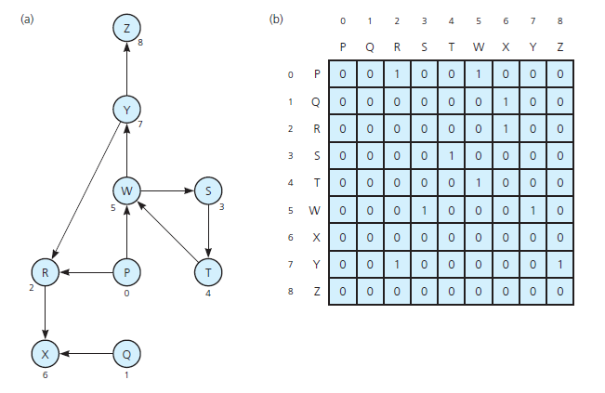
Implementing Graphs

Slide 40
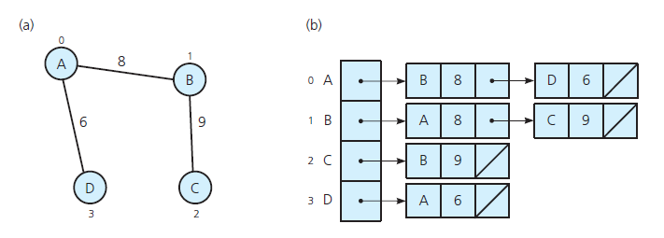
Implementing Graphs
(a) A weighted undirected graph and (b) its adjacency list

Slide 41

Graph Implementation
Array-based implementation
A 1D array is used to represent the vertices
A 2D array (adjacency matrix) is used to represent the edges

Slide 42
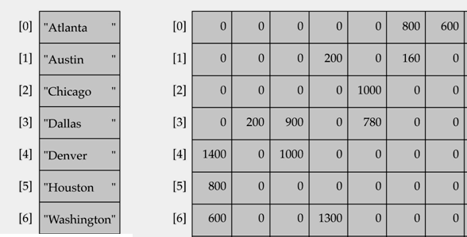
Array-based implementation

Slide 43

Graph Implementation (Cont.)
Linked-list implementation
A 1D array is used to represent the vertices
A list is used for each vertex v which contains the vertices which are adjacent from v (adjacency list)

Slide 44
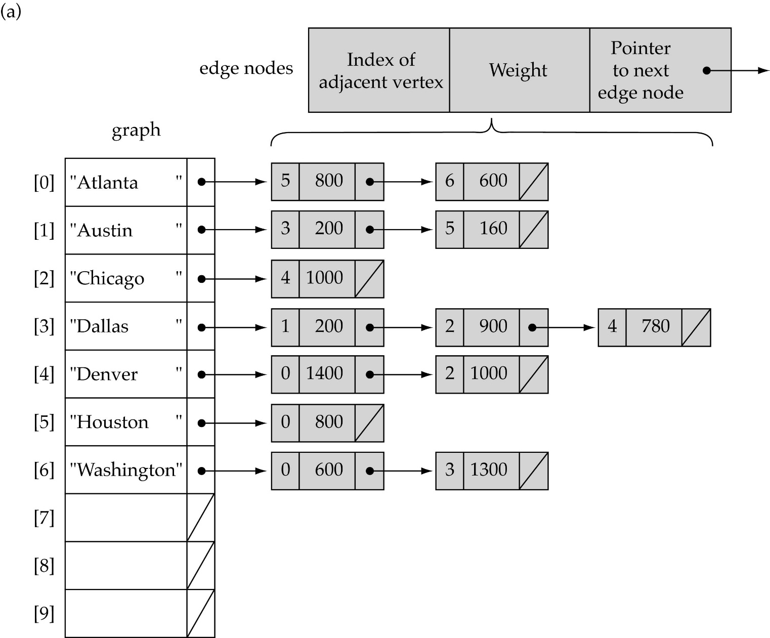
Linked-list implementation

Slide 45
Minimum spanning trees (MST)
It may be defined on Euclidean space points or on a graph.
G = (V, E): weighted connected undirected graph
Spanning tree : S = (V, T), T ⊆ E, undirected tree
Minimum spanning tree(MST) : a spanning tree with the smallest total weight.

Slide 46
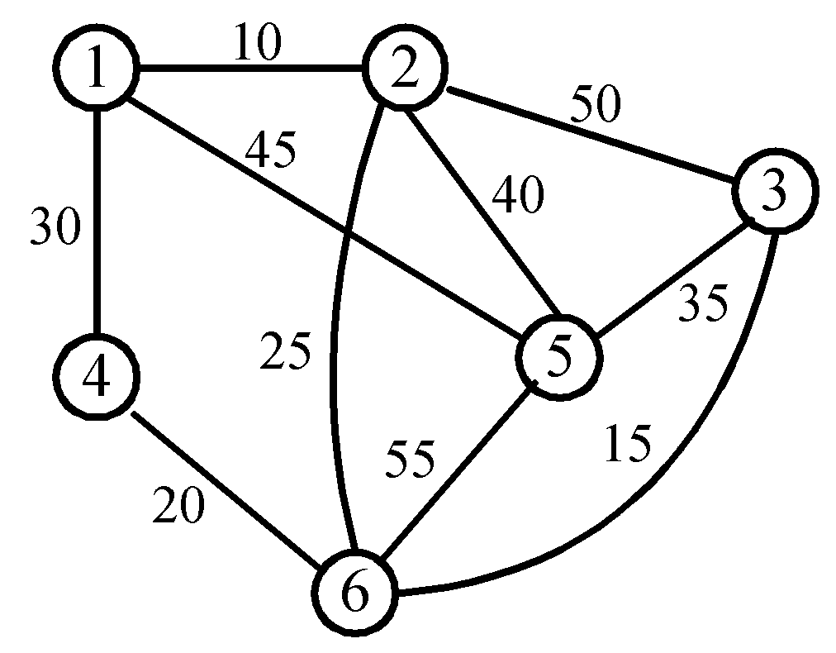
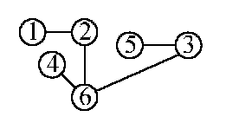
An example of MST
A graph and one of its minimum costs spanning tree

Slide 47
Kruskal’s algorithm for finding MST
Step 1: Sort all edges into nondecreasing order.
Step 2: Add the next smallest weight edge to the forest if it will not cause a cycle.
Step 3: Stop if n-1 edges. Otherwise, go to Step2.

Slide 48
Kruskal’s algorithm
In this algorithms we order the weights in ascending order and select those routes only that may not cause any cycle

Slide 49
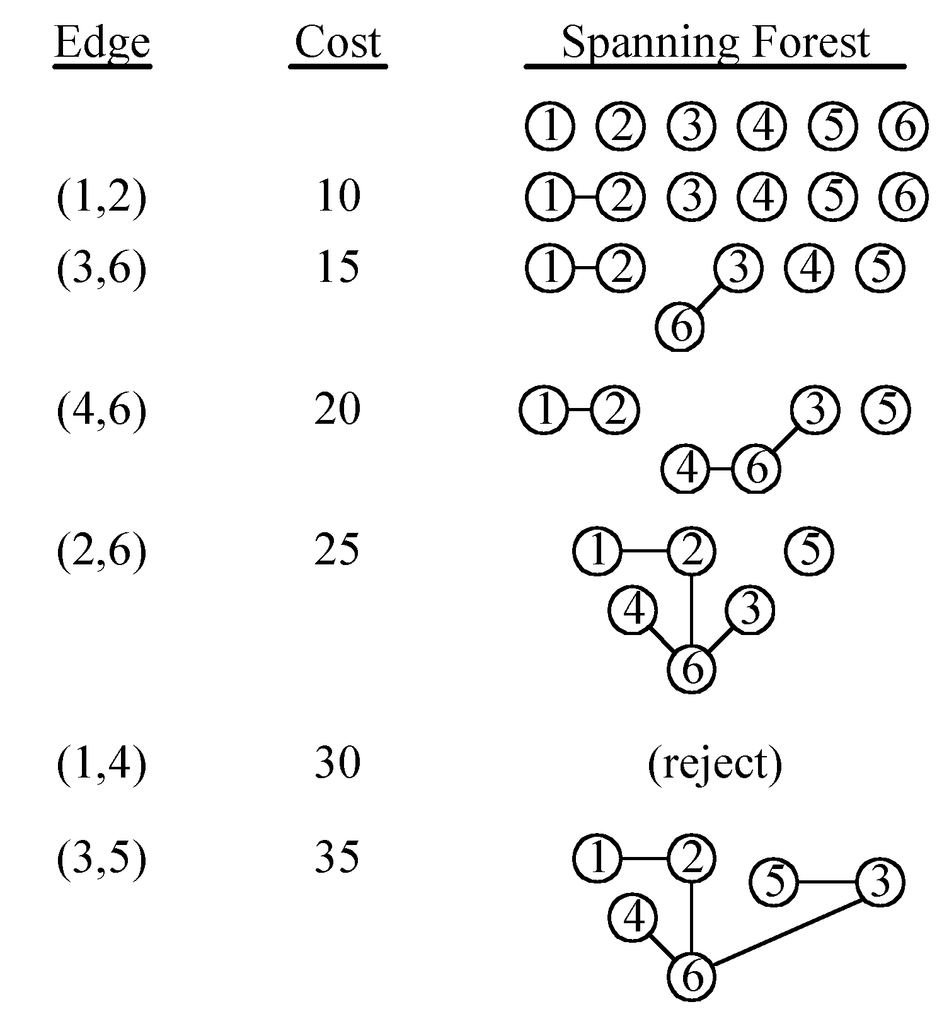
An example of Kruskal’s algorithm

Slide 50
Prim’s algorithm for finding MST
Step 1: x ∈ V, Let A = {x}, B = V - {x}.
Step 2: Select (u, v) ∈ E, u ∈ A, v ∈ B such that (u, v) has the smallest weight between A and B.
Step 3: Put (u, v) in the tree. A = A ∪ {v}, B = B - {v}
Step 4: If B = ∅, stop; otherwise, go to Step 2.
Time complexity : O(n²), n = |V|.
(see the example on the next page)
Notes:
V is vertex

Slide 51
An example for Prim’s algorithm

Slide 52
Prim’s Algorithm Example for MST
A={ }
B={1,2,3,4,5,6}
At First Step:
A={1}
B={2,3,4,5,6} 1-2= 10, 1-3= Nil,1-4=30,1-5=45,1-6=Nil
smallest=10 that is from 1 to 2
1
1
2

Slide 53
Prim’s Algorithm Example for MST
At Second Step:
A={1,2}
B={3,4,5,6}
1-3= Nil, 1-4= 30,1-5=45,1-6=Nil
2-3= 50, 2-4= Nil,2-5=40,2-6=25
smallest = 25 that is from 2 to 6
1
2
1
2
6

Slide 54
Prim’s Algorithm Example for MST
At third Step:
A={1,2,6}
B={3,4,5}
1-3= Nil, 1-4= 30,1-5=45
2-3= 50, 2-4= Nil,2-5=40
6-3= 15, 6-4= 20,6-5=55
smallest = 15 that is from 6 to 3
1
2
6
1
2
6
3

Slide 55
Prim’s Algorithm Example for MST
At fourth Step:
A={1,2,6,3}
B={4,5}
1-4= 30,1-5=45
2-4= Nil,2-5=40
6-4= 20,6-5=55
3-4= Nil,3-5=35
smallest = 20 that is from 6 to 4
1
2
6
3
1
2
6
3
4

Slide 56
Prim’s Algorithm Example for MST
At fifth Step:
A={1,2,6,3,4}
B={5}
1-5=45
2-5=40
6-5=55
3-5=35
4-5=Nil
smallest = 35 that is from 3 to 5
1
2
6
3
4
1
2
6
3
5
4

Slide 57
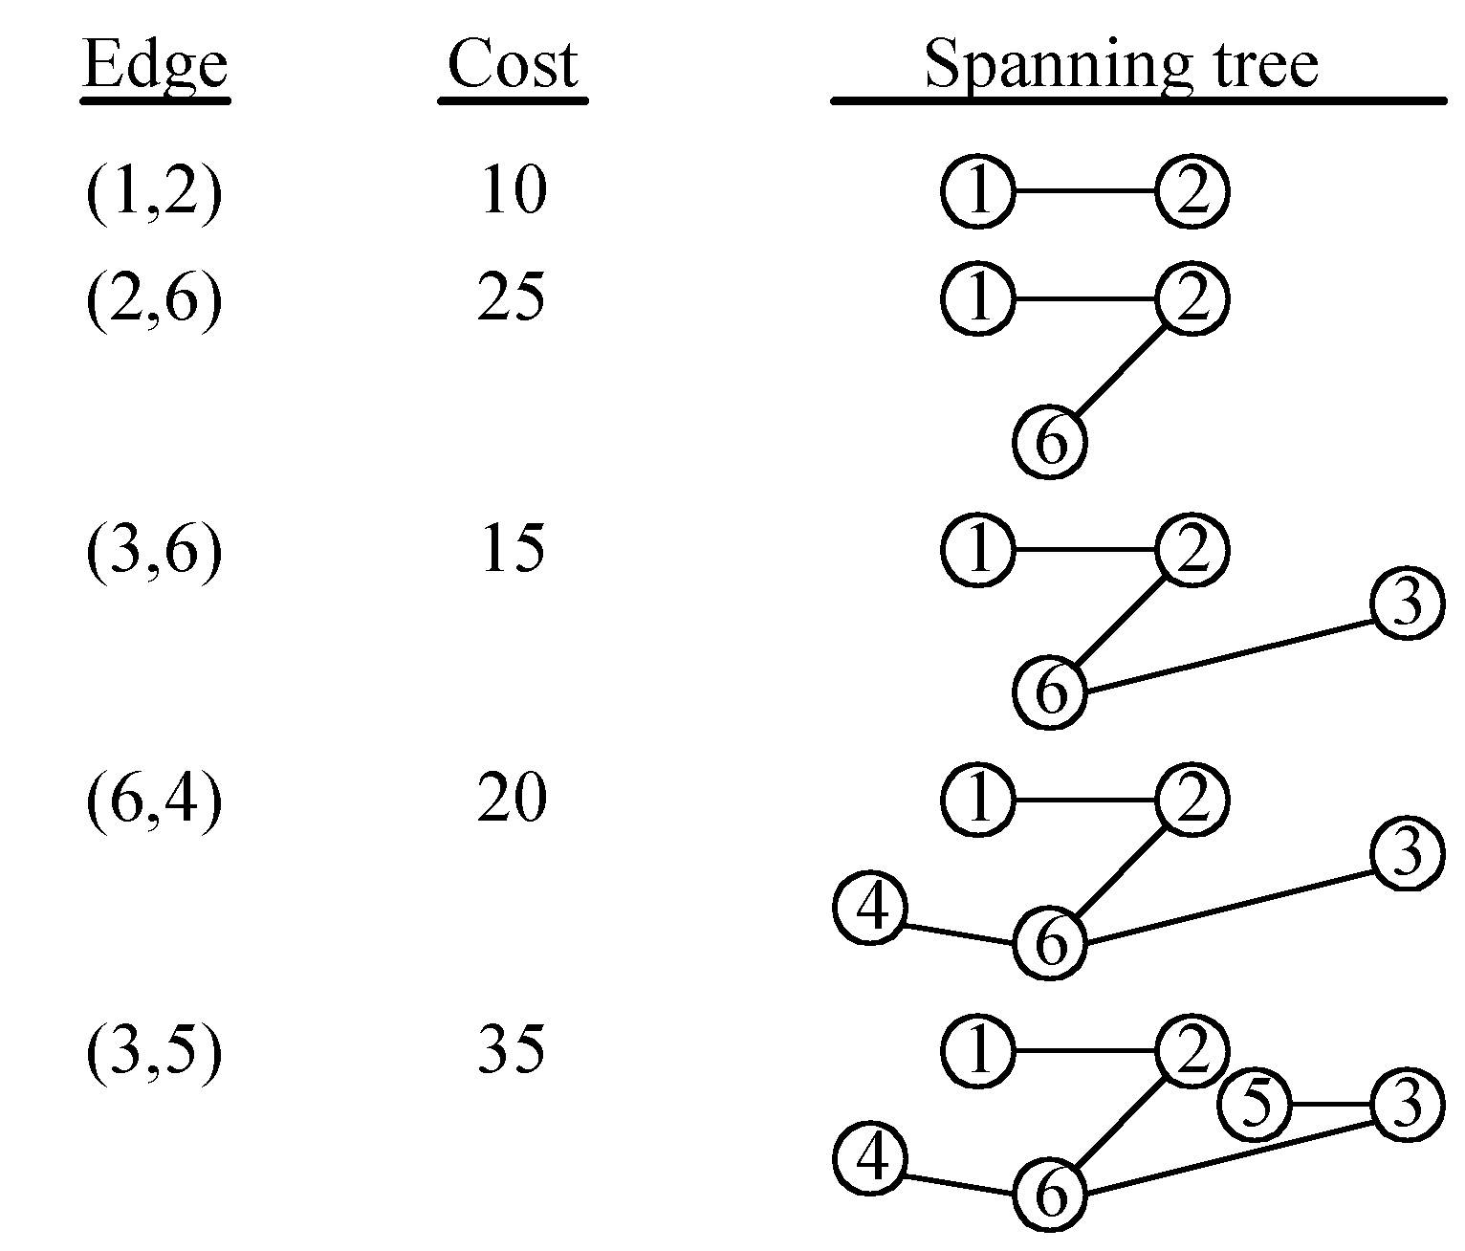
An example for Prim’s algorithm

Slide 58
Graph Traversal/ searching
Problem: Search for a certain node or traverse all nodes in the graph
Depth First Search
Once a possible path is found, continue the search until the end of the path
Breadth First Search
Start several paths at a time, and advance in each one step at a time

Slide 59
Depth-First-Search (DFS)
What is the idea behind DFS?
Travel as far as you can down a path
Back up as little as possible when you reach a "dead end" (i.e., next vertex has been "marked" or there is no next vertex)
DFS can be implemented efficiently using a stack

Slide 60
DFS
Algorithm:
Starting Node is A
1. Initialize all nodes to ready state(Status=1)
2. Push starting nose A onto Stack and change its status to waiting state (Status=2).
3.Repeat steps 4 & 5 until STACK is empty.
4. Pop Top node N. Process N and change its Status to the processed state (Status=3).
5.Push onto Stack all the neighbors of N that are still in ready state and change their state as waiting state(State=2).
6. Exit.

Slide 61
Depth-First Search

Slide 62
Exploring a twist Without Getting Lost
A depth-first search (DFS) in an undirected graph G is like wandering in a labyrinth with a string and a can of red paint without getting lost.
We start at vertex s, tying the end of our string to the point and painting s “visited”. Next we label s as our current vertex called u.
Now we travel along an arbitrary edge (u, v).
If edge (u, v) leads us to an already visited vertex v we return to u.
If vertex v is unvisited, we unroll our string and move to v, paint v “visited”, set v as our current vertex, and repeat the previous steps.

Slide 63
Breadth-First-Searching (BFS)
What is the idea behind BFS?
Look at all possible paths at the same depth before you go at a deeper level
Back up as far as possible when you reach a "dead end" (i.e., next vertex has been "marked" or there is no next vertex)

Slide 64
BFS
Algorithm:
Starting Node is A
1. Initialize all nodes to ready state(Status=1)
2. Push starting nose A onto Queue and change its status to waiting state (Status=2).
3.Repeat steps 4 & 5 until Queue is empty.
4. Remove the front node N. Process N and change its Status to the processed state (Status=3).
5.Add to the rear of Queue all the neighbors of N that are still in ready state and change their state to waiting (State=2).
6. Exit.

Slide 65
Breadth-First Search
Like DFS, a Breadth-First Search (BFS) traverses a connected component of a graph, and in doing so defines a spanning tree with several useful properties.
The starting vertex s has level 0, and, as in DFS, defines that point as an “anchor.”
In the first round, the string is unrolled the length of one edge, and all of the edges that are only one edge away from the anchor are visited.
These edges are placed into level 1
In the second round, all the new edges that can be reached by unrolling the string 2 edges are visited and placed in level 2.
This continues until every vertex has been assigned a level.
The label of any vertex v corresponds to the length of the shortest path from s to v.

Slide 66
BFS - A Graphical Representation
a)
b)
c)
d)

Slide 67
More BFS

Slide 68
Applications: Finding a Path
Find path from source vertex s to destination vertex d
Use graph search starting at s and terminating as soon as we reach d
Need to remember edges traversed
Use depth – first search ?
Use breath – first search?

Slide 69
DFS vs. BFS
DFS Process
F
B
A
start
E
G
D
C
destination
C
DFS on C
D
Call DFS on D
B
DFS on B
B
B
Return to call on B
A
DFS on A
A
A
A
G
Call DFS on G
found destination - done!
Path is implicitly stored in DFS recursion
Path is: A, B, D, G
D
B
A

Slide 70
DFS vs. BFS
F
B
A
start
E
BFS Process
G
D
C
destination
rear
front
rear
front
rear
front
rear
front
A
B
D
C
D
Initial call to BFS on A
Add A to queue
Dequeue A
Add B
Dequeue B
Add C, D
Dequeue C
Nothing to add
rear
front
G
found destination - done!
Path must be stored separately
Dequeue D
Add G

